Slide 1
An Analysis of the World Suicide Data
Project Team #7
Mujgan Guner, Ahmed Lotfy, Shanker Nair
June 25, 2020

Slide 2
Introduction
Suicide is a public health problem and one of the leading cause of death globally.
Organizations such as WHO, NIMH and many countries’ public health organizations collect and analyze data related to suicide.
“Suicide rates overview 1985 to 2016” from Kaggle is used.
The dataset is in “csv” format.

Slide 3
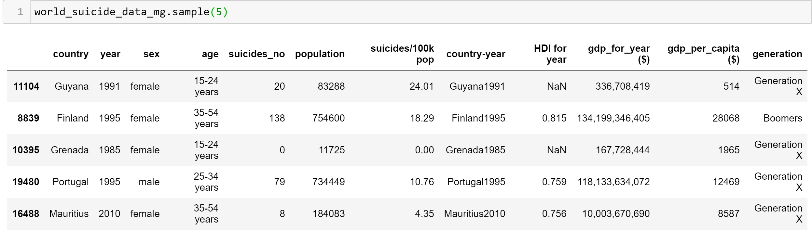
Dataset Overview
There are 12 columns and 27820 rows in the dataset.
Continents and Latitudes data are added later for further analysis.
14 columns
HDI for year column is removed due to Null values.

Slide 4
Dataset Overview …
The dataset covers the years from 1985 to 2016.
However, reporting of the data is not very consistent per year and per countries
Therefore, data slicing was applied considering different year periods to stay consistent with the countries and years.
Notes:
So our dataset covers the years from 1985 to 2016. However, we noticed that unfortunately not every year has consistently the same countries per reported year. For example data of Albania exists in 1985 but not in year 2000.
Therefore each team member sliced the data differently while keeping the consistency of years and countries within their data slice.

Slide 5
Research Questions
What is the global trend in the suicide rate over the years?
Are men or women more likely to commit suicide?
Do suicide and the wealth of a country correlate?
Which age group is more susceptible to suicide?
Which countries and continents have higher suicide rates?

Slide 6
Data Slice Insights
Focus on the data between Year 2000 and 2010 (rich of data)
Merged with continent data
94 different countries from all over the globe were involved

Slide 7
The Global Trend

Slide 8
Global Trend By Country

Slide 9
Top 5 Countries

Slide 10
Suicide Rate Per Continent

Slide 11
Age Group

Slide 12
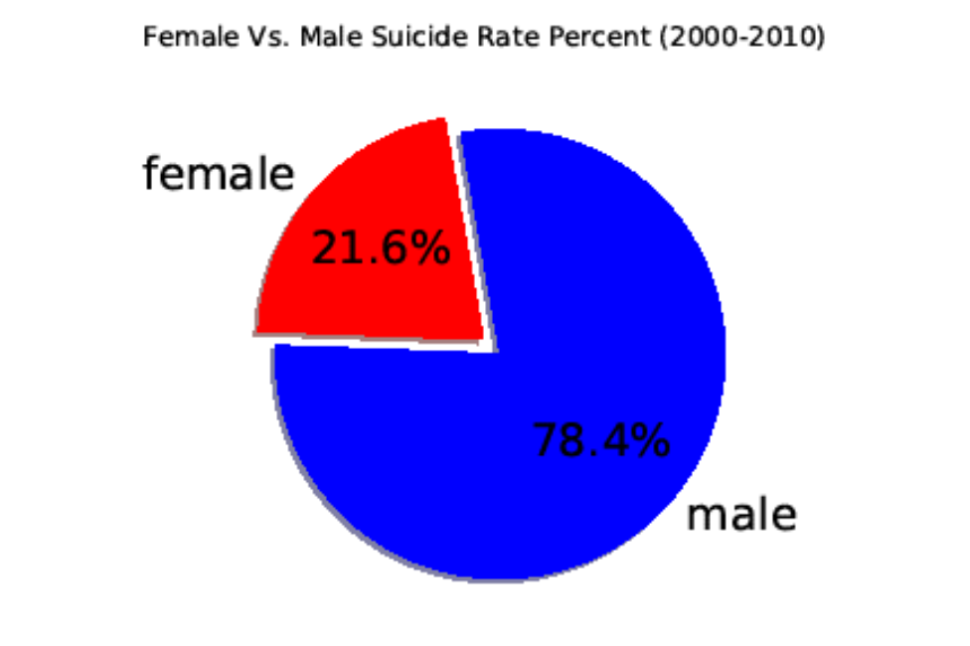
Gender Likelihood
The male has 3.6 times higher suicide rate comparing to the female

Slide 13
Economic Impact
Correlation
The correlation coefficient between both factors is 0.09
Very weak correlation between the GDP and the Suicide Rate

Slide 14
Economic Impact
The R-squared value (1 %) indicates that none of the variability around its mean

Slide 15
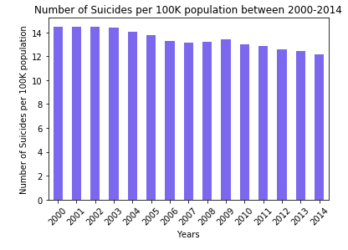
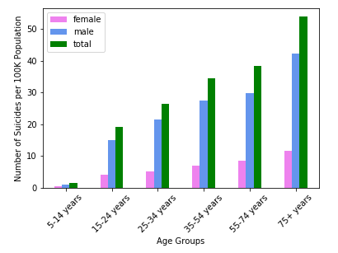
Global Suicide Rate Between 2000-2014 (58 Countries)
Notes:
I have taken a look at the data of 15 years from 2000 to 2014. My findings in demographics relationship, age group and suicide rates confirm Ahmed’s findings.
But when I take a look at the suicide rate with respect to years, I noticed that there is a slight increase in year 2009 as compared to the previous couple of years.

Slide 16
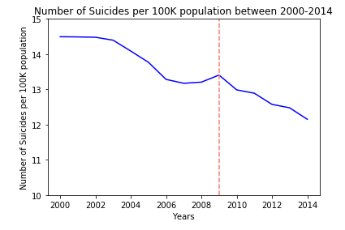
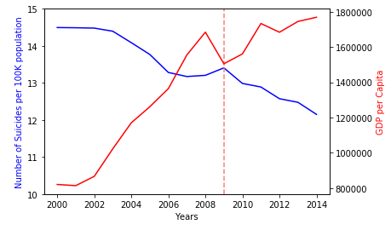

Global Suicide Rate and GDP per Capita
Overall, GDP per capita in the world increased over the year, while the suicide rate was decreasing.
There is a slight increase in the suicide rate in 2009, while the total GDP per capita shows a decrease.

Slide 17
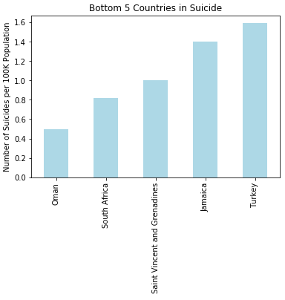
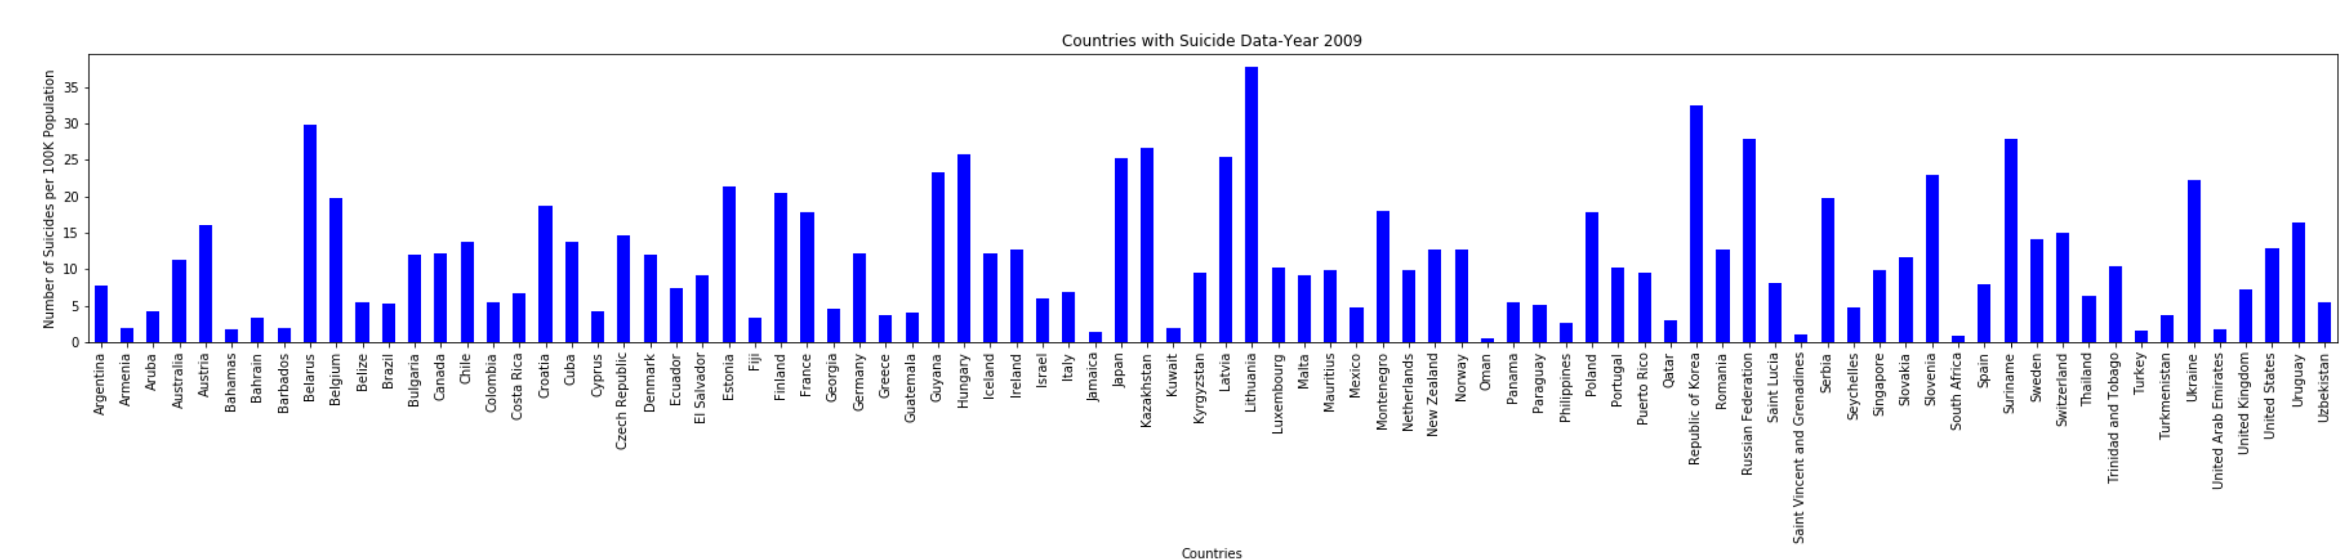
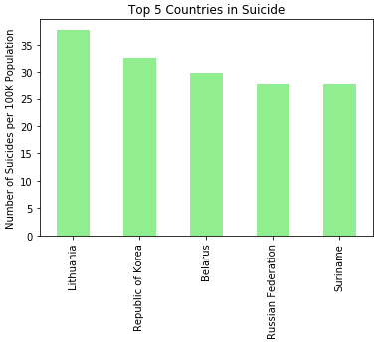
Data Slice of Year 2009 (86 countries)

Slide 18
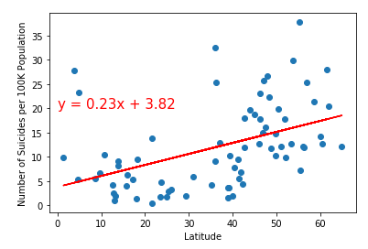
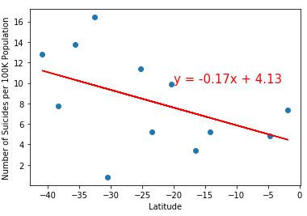
Suicide Rate and Latitude (Data Slice for 2009)
Weak correlation between latitude and suicide rate
Northern Hemisphere
Southern Hemisphere

Slide 19
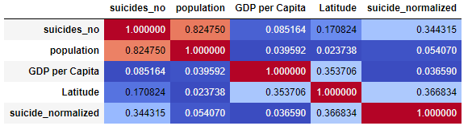
Correlation Matrix of 2009 Data
Pearson r Values

Slide 20
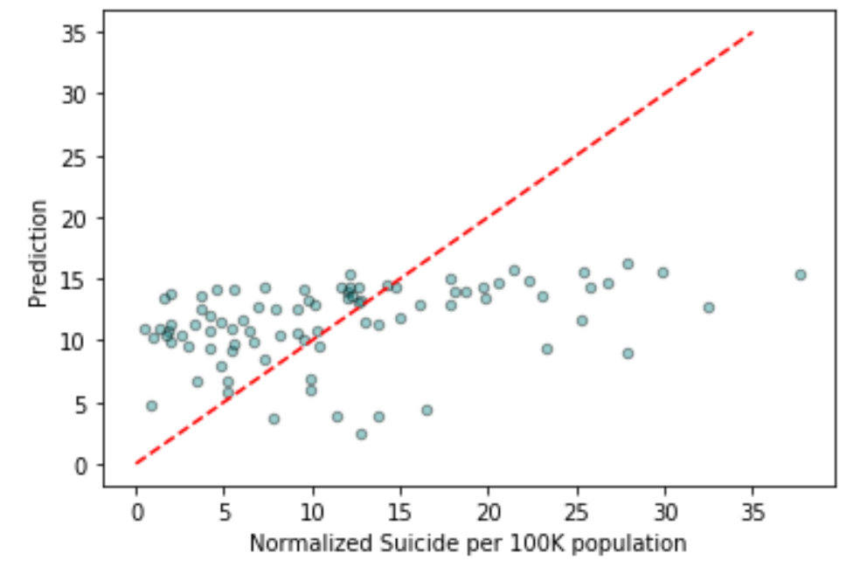

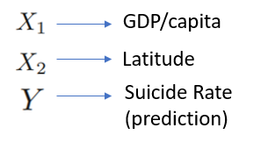
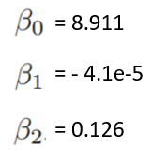
Multiple Linear Regression
Coefficients Calculated

Slide 21
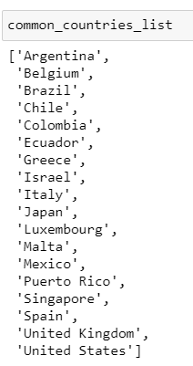
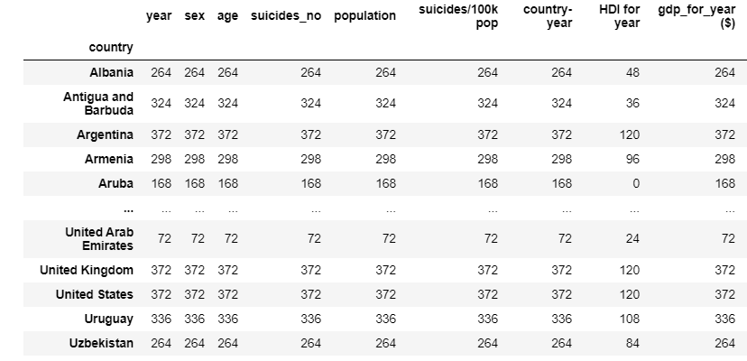
Data QC and Clean-up
Total countries: 18
Time frame: 31 years
(1987 to 2016)
Append kaggle data with continents
Data filtering methodology:
Data over multiple years?
OR
Data over multiple countries?
Final country list
Final column list
Country
Year
Sex
Age
Suicides_No
Population
Suicides/100K Pop
Country-Year
Hdi For Year
Gdp_For_Year ($)
Gdp_Per_Capita ($)
Generation
Continent
31 years * 12 months
=
372

Slide 22
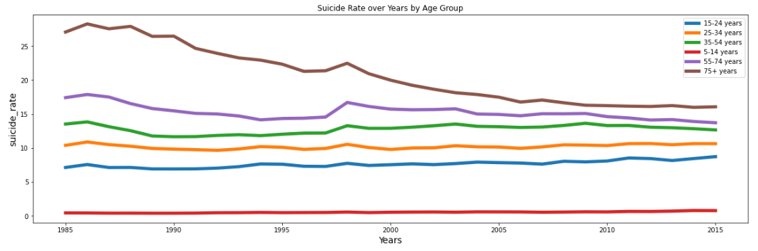
Suicide Rate by Age Group
The suicide rate increases systematically/proportionally with age increase.
Lowest age group- Lowest suicide rate.
Highest age group – Highest suicide rate

Slide 23
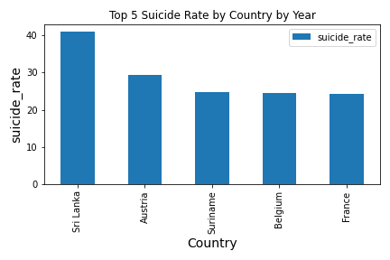
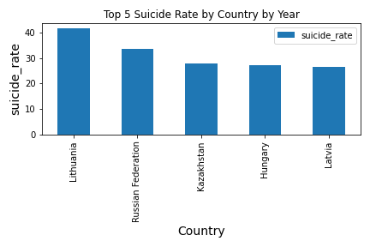
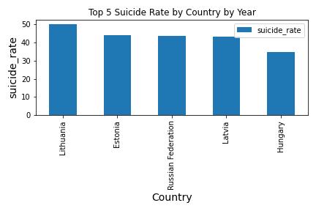
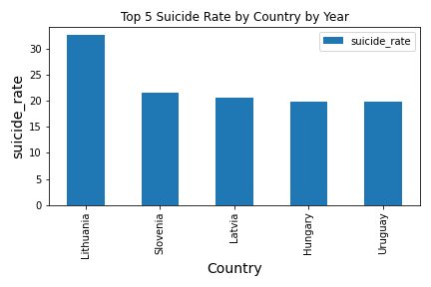
Top 5 Countries by Year
1985
2005
1995
2015

Slide 24
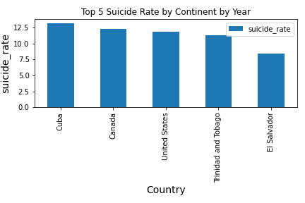
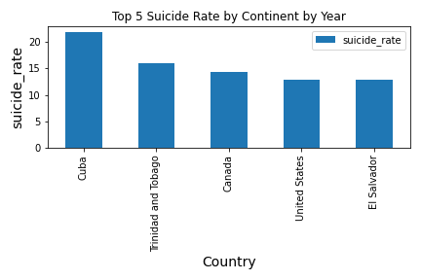
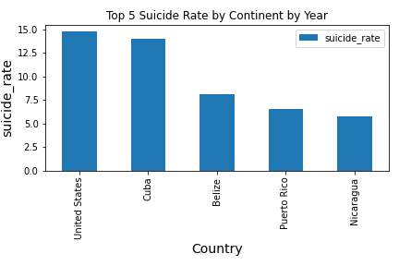
Top 5 Countries by North America
2005
1995
2015

Slide 25
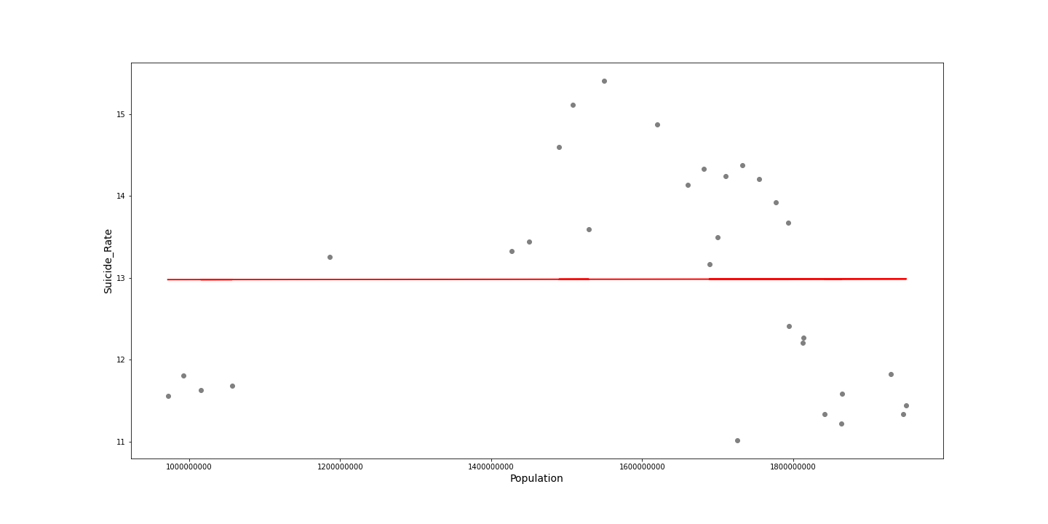
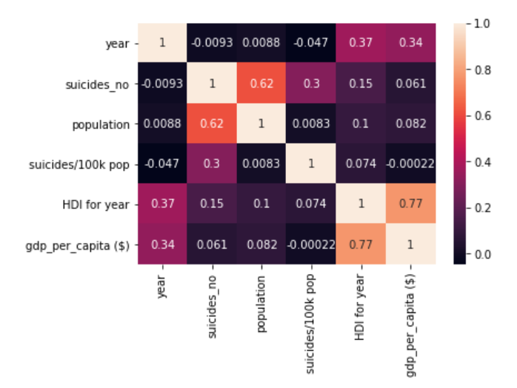
Correlation Matrix

Slide 26
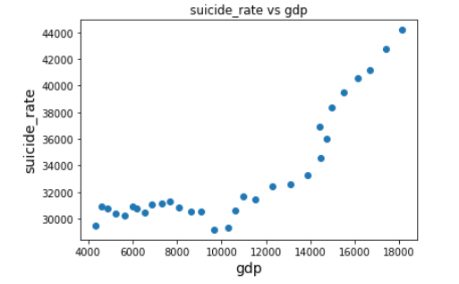
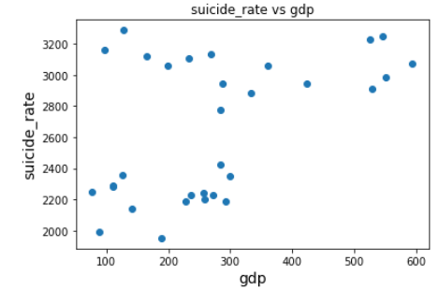
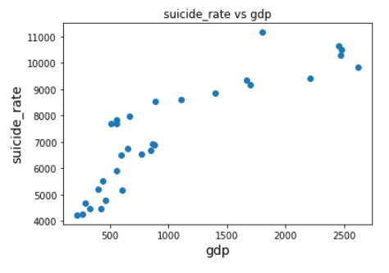
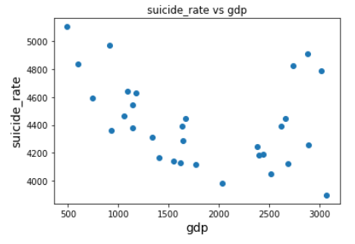
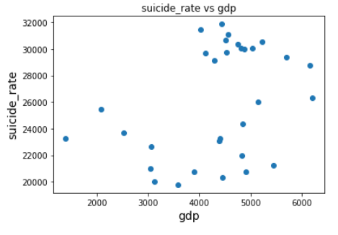
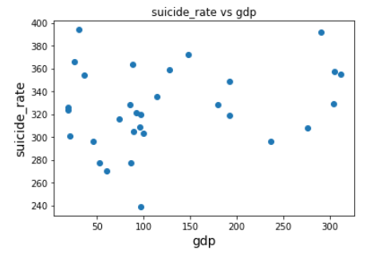
Suicide Rate versus GDP by Country
USA
Argentina
Brazil
UK
Japan
Singapore

Slide 27
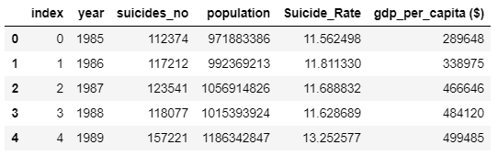
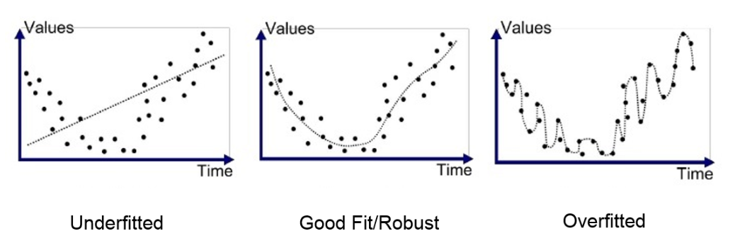
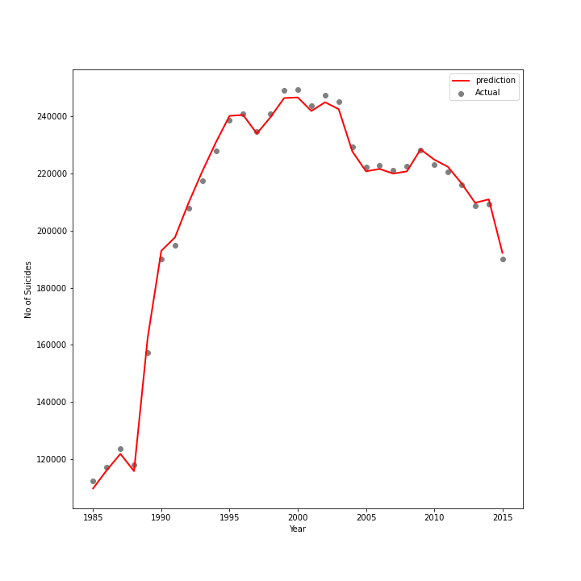
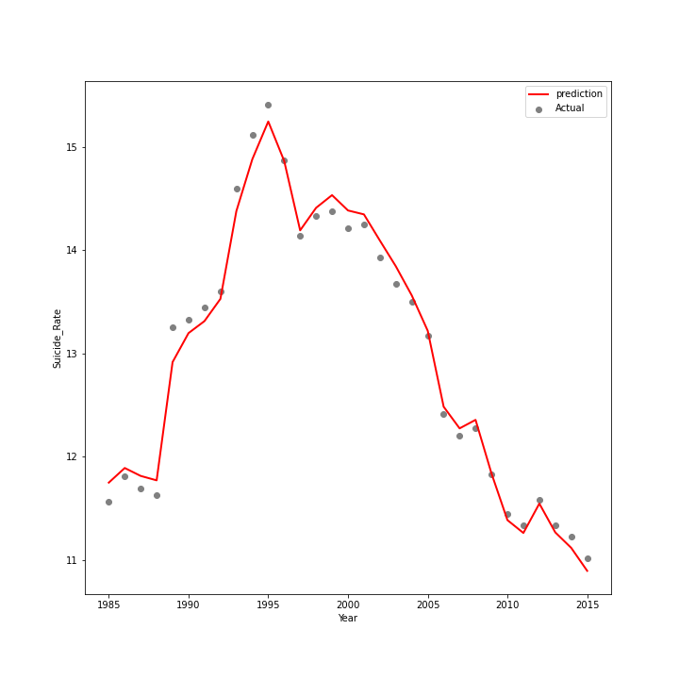
Multivariate Regression
Independent variables:
Population
Gdp per capita
Year
Dependent variables:
Suicide Rate
No. of Suicides
Suicide Rate
https://medium.com/analytics-vidhya/multiple-linear-regression-with-python-98f4a7f1c26c

Slide 28
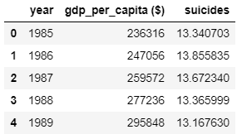
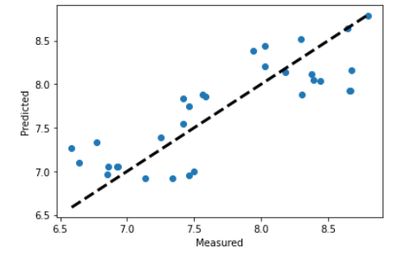
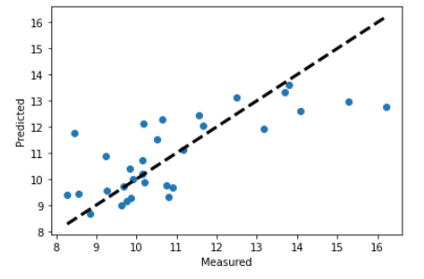
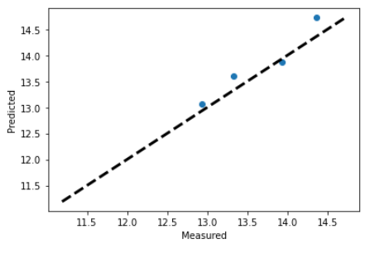
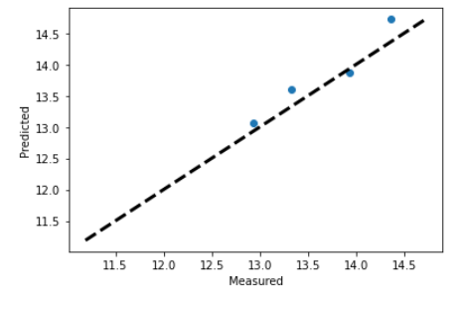
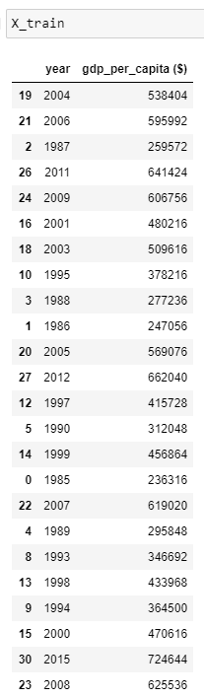
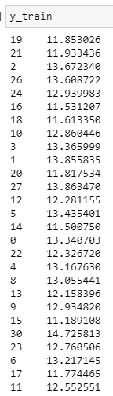
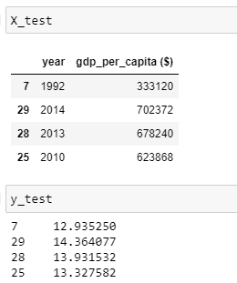
Multivariate regression- Method 2
31 years total
Training Data set
90% data for training model
Test Data set
- 10% data for testing
Training Data set
Test Data set
USA
RMSE: 0.23
Range: 3.5
R^2: 0.81
SINGAPORE
RMSE: 1.3
R^2: 0.56
ITALY
RMSE: 0.25
Range: 3.5
R^2: 0.78
ITALY
RMSE: 0.38
R^2: 0.68
https://heartbeat.fritz.ai/implementing-multiple-linear-regression-using-sklearn-43b3d3f2fe8b
https://medium.com/analytics-vidhya/multiple-linear-regression-with-python-98f4a7f1c26c
https://www.ncbi.nlm.nih.gov/pmc/articles/PMC4530125/#:~:text=A%20useful%20rule%20of%20thumb,range%20of%20target%20property%20value.

Slide 29
CONCLUSIONS
The male suicide rate was much more than the female suicide rate.
The highest suicide rate was observed in the oldest age group (75+).
On a population normalized basis, Europe had the highest suicide rate out of 6 other continents.
Strong correlations are not observed between suicide rate, population, GDP per capita and the central latitude of the countries.

